Slide 1

”We want to stay”
Notes:
Johanna
Tell a story:
You are refugee who just arrived in Aachen
You go to local activities organized by the community to meet new people.
A nice conversation develops and everything is going great, but then the topic starts to wander to where you came from.
You say you are from Syria and then they question you on why came to germany?.
You say you are a refugee and all of a sudden you feel a barrier being put between you and them.
THIS IS THE PROBLEM:

Slide 2

Local prejudice hinders contact because people believe refugees are different.
Notes:
Miri
Tell a story:
You are refugee who just arrived in Aachen
You go to local activities organized by the community to meet new people.
A nice conversation develops and everything is going great, but then the topic starts to wander to where you came from.
You say you are from Syria and then they question you on why came to germany?.
You say you are a refugee and all of a sudden you feel a barrier being put between you and them.
THIS IS THE PROBLEM:

Slide 3






Notes:
Miri
Value
societal value
Desensitization
Identification with daily struggles
A platform providing information and opens for discussion
An opportunity to express yourself

Slide 4

Desensitization of the word “refugee”
Out of own will
Interaction
Create the bridge
Notes:
Juli
Magic
Desensitization of the word refugee
Unobstrusive / out of own will
Create the bridge towards downloading an app to meet refugees/friends
Interaction in the background and on the platform itself

Slide 5
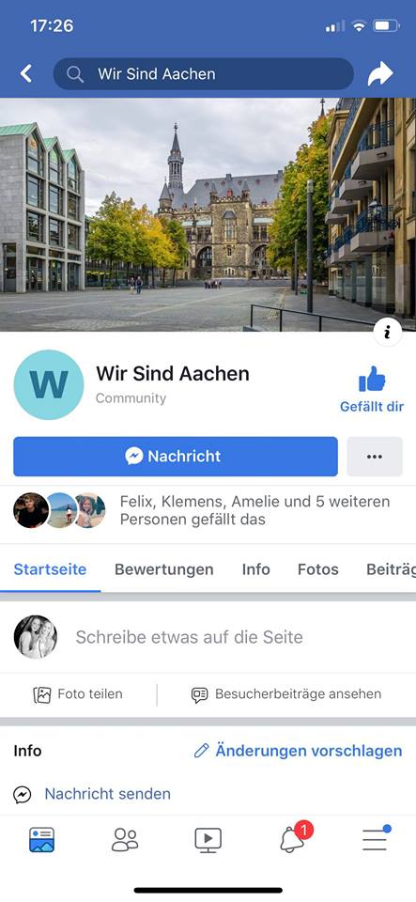
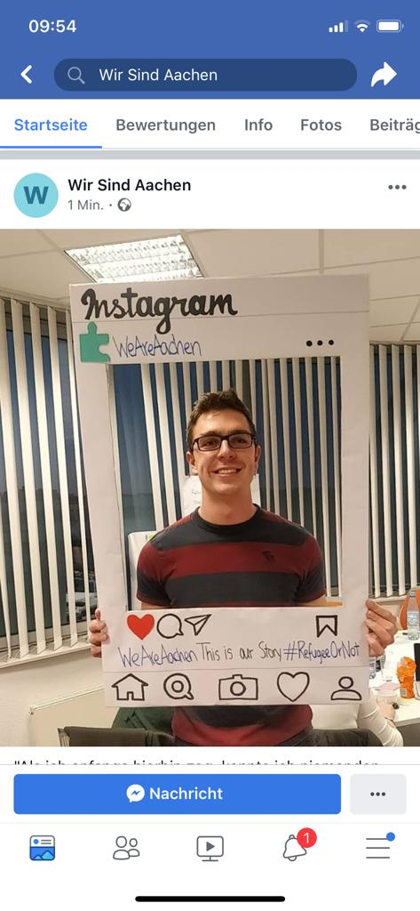
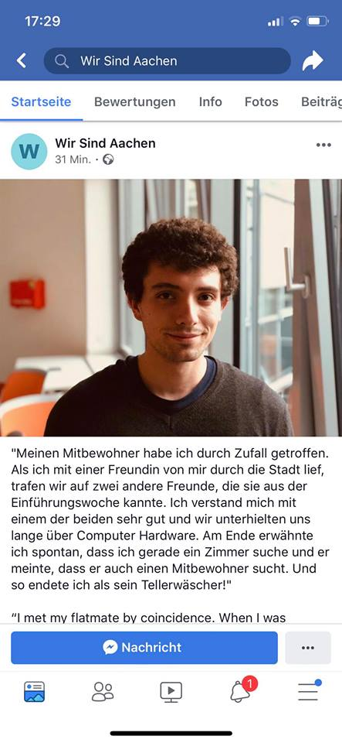
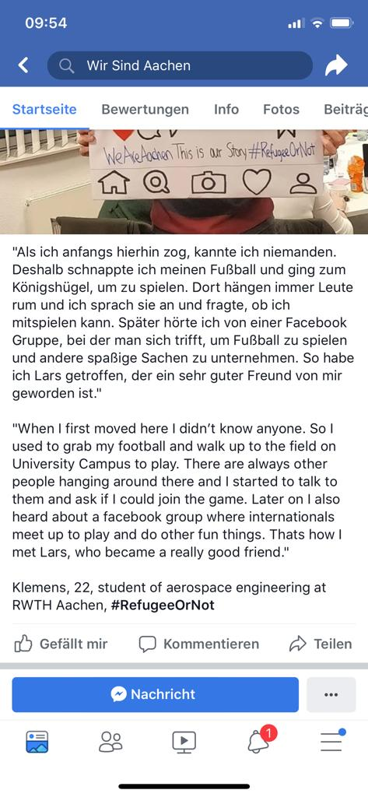
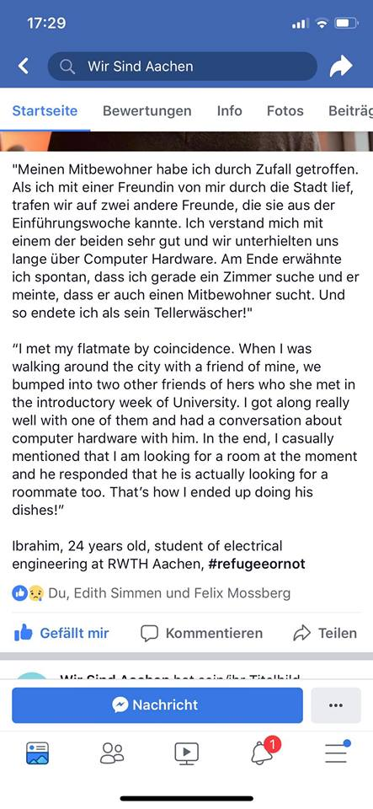
Notes:
Klemens
Explain the Facebook Page
Story 1

Slide 6


234
26
Notes:
Klemens
Explain the Facebook Page
Story 1

Slide 7
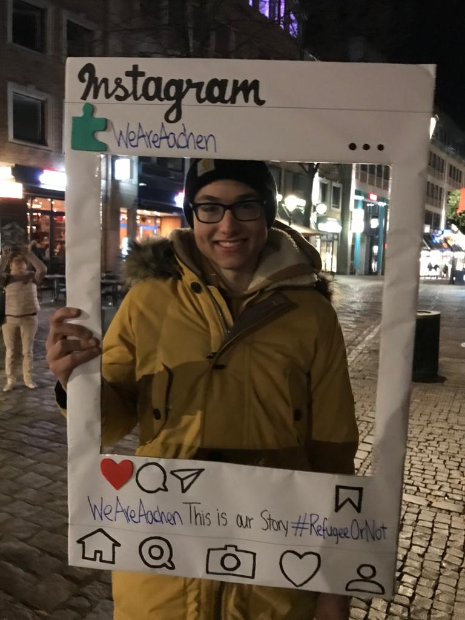
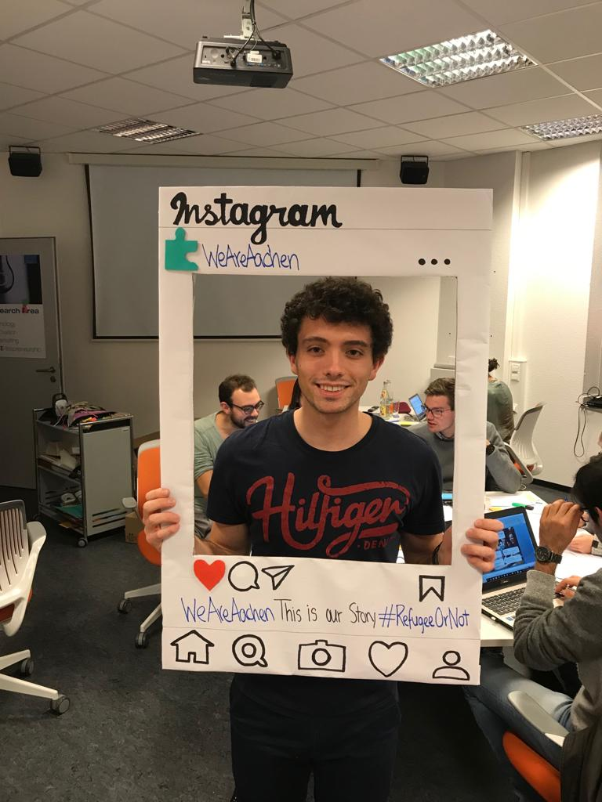
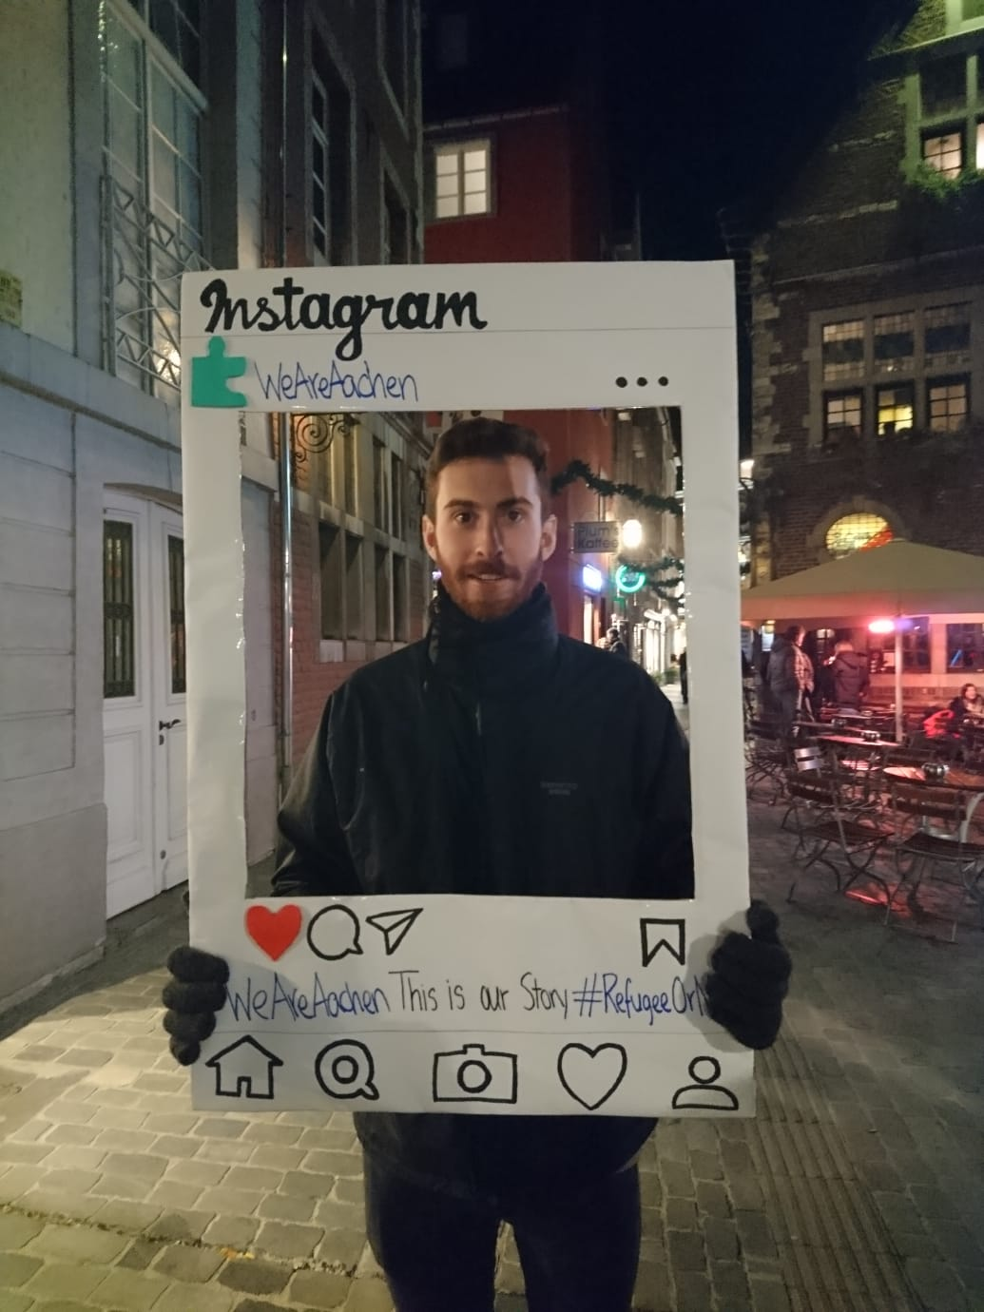
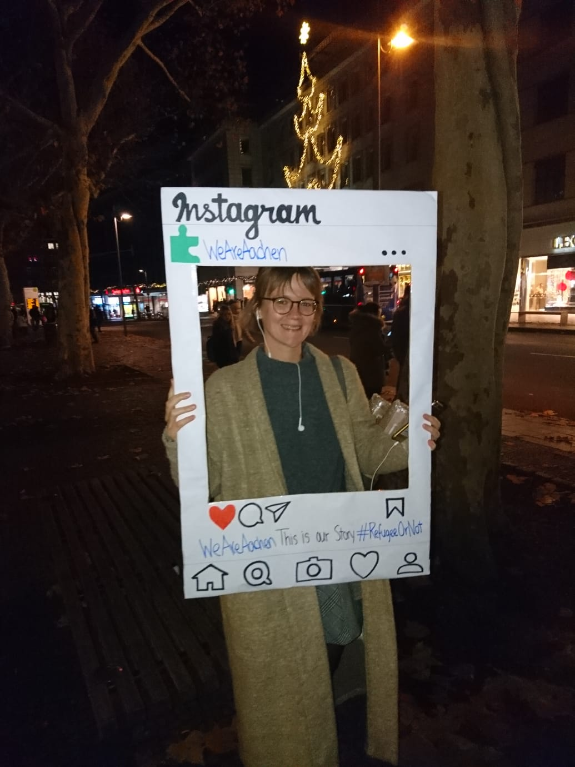
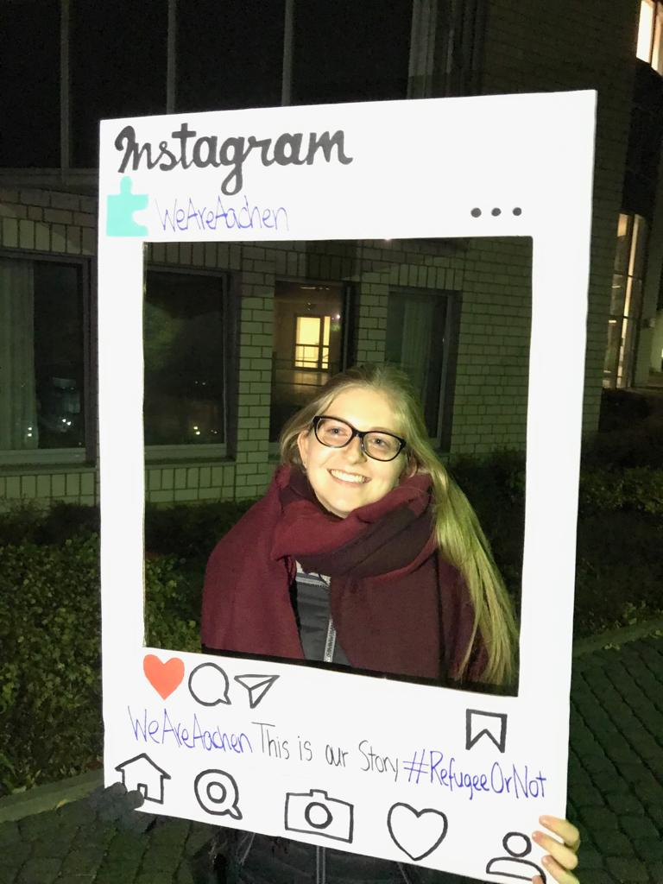
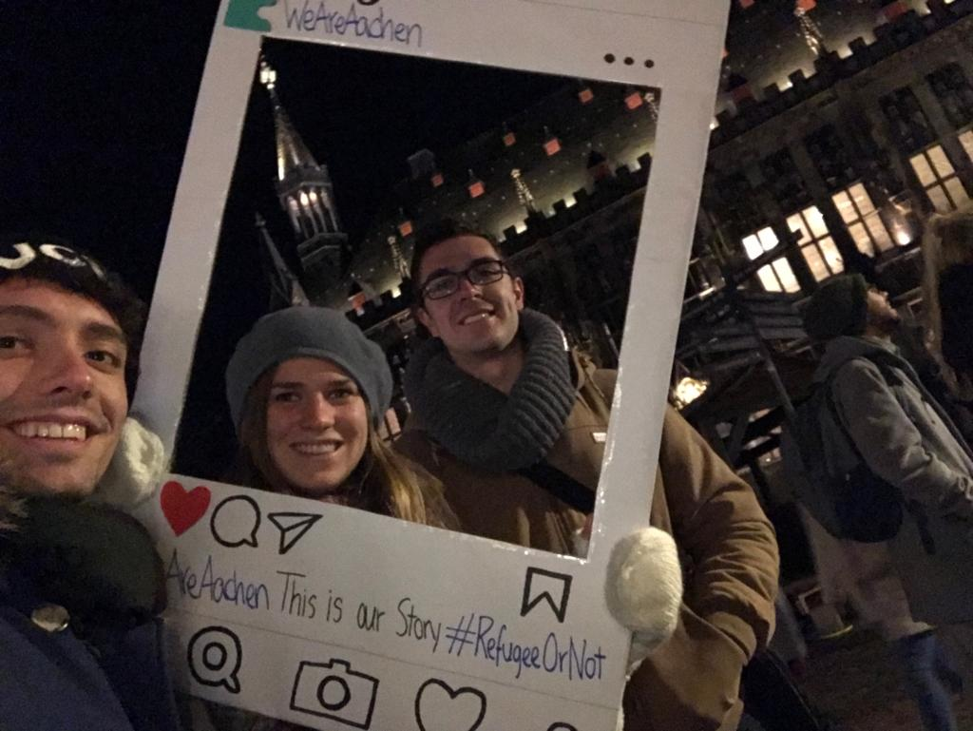
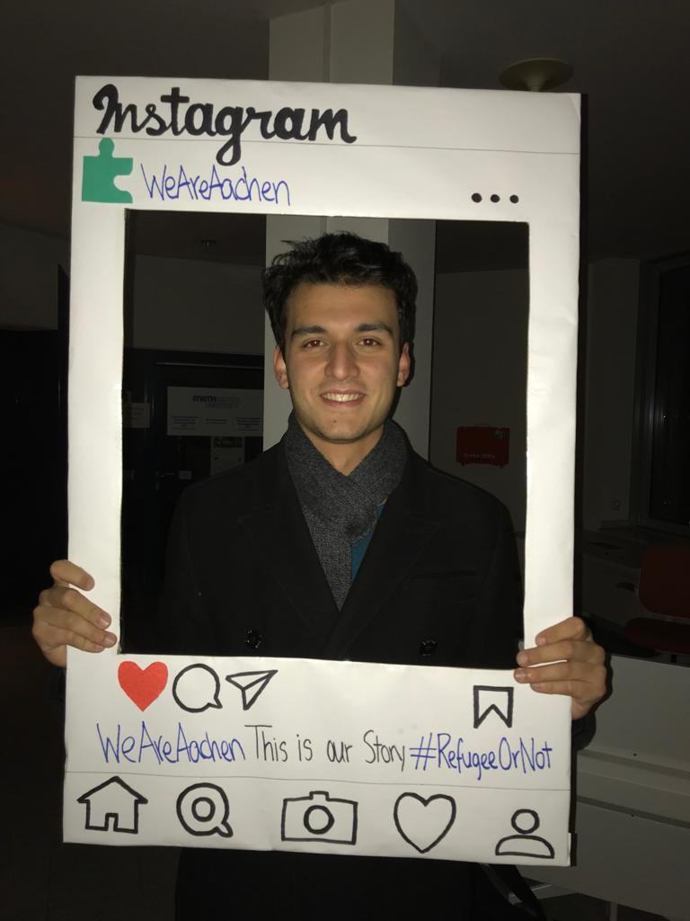
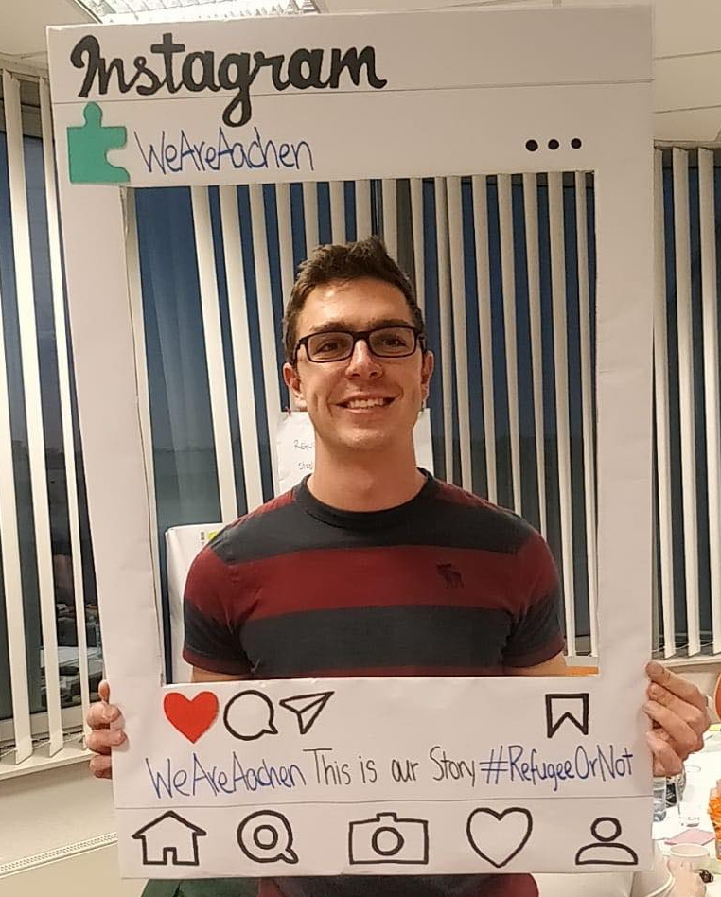
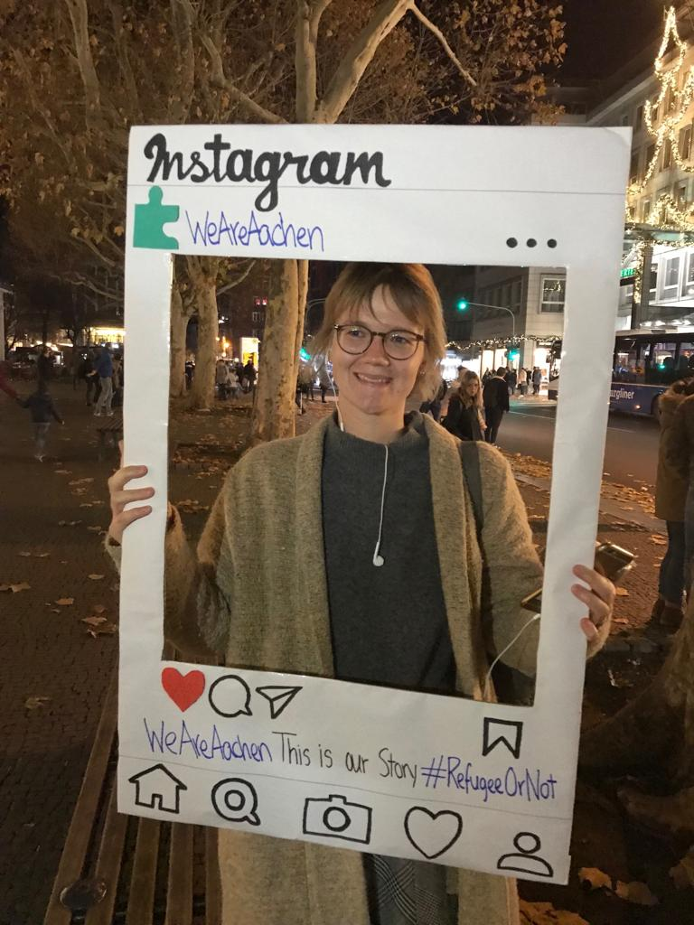
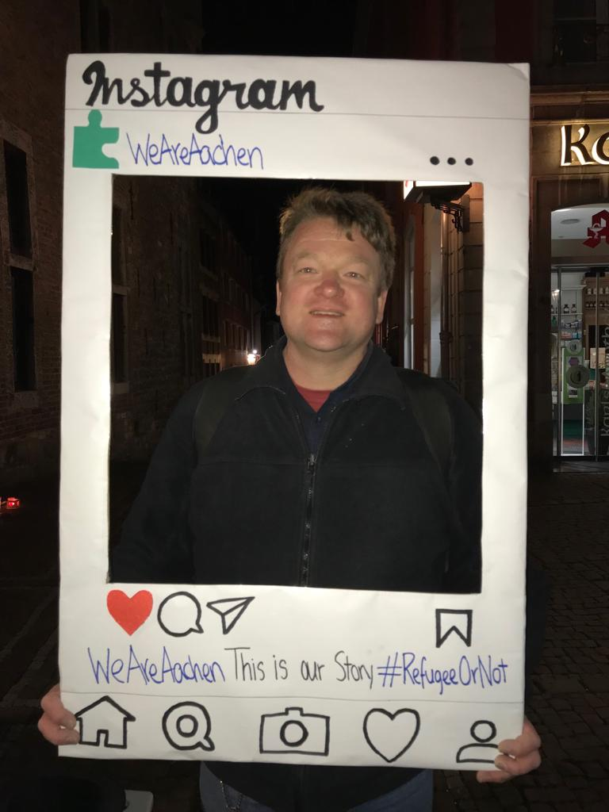
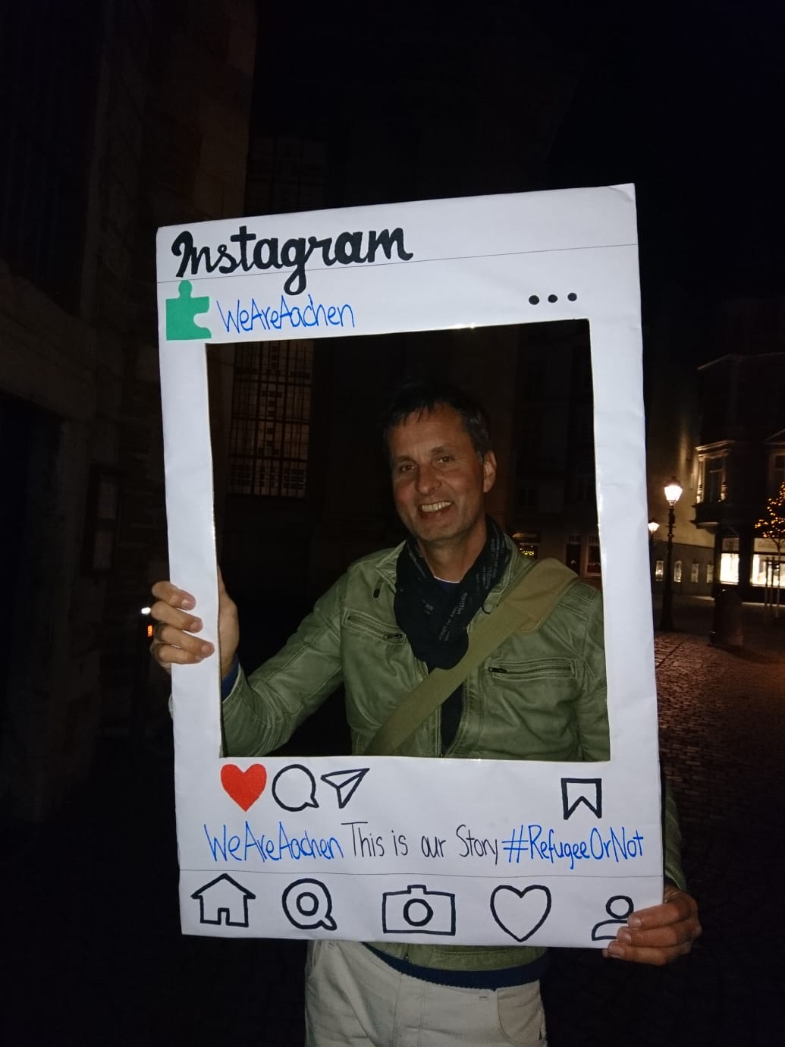
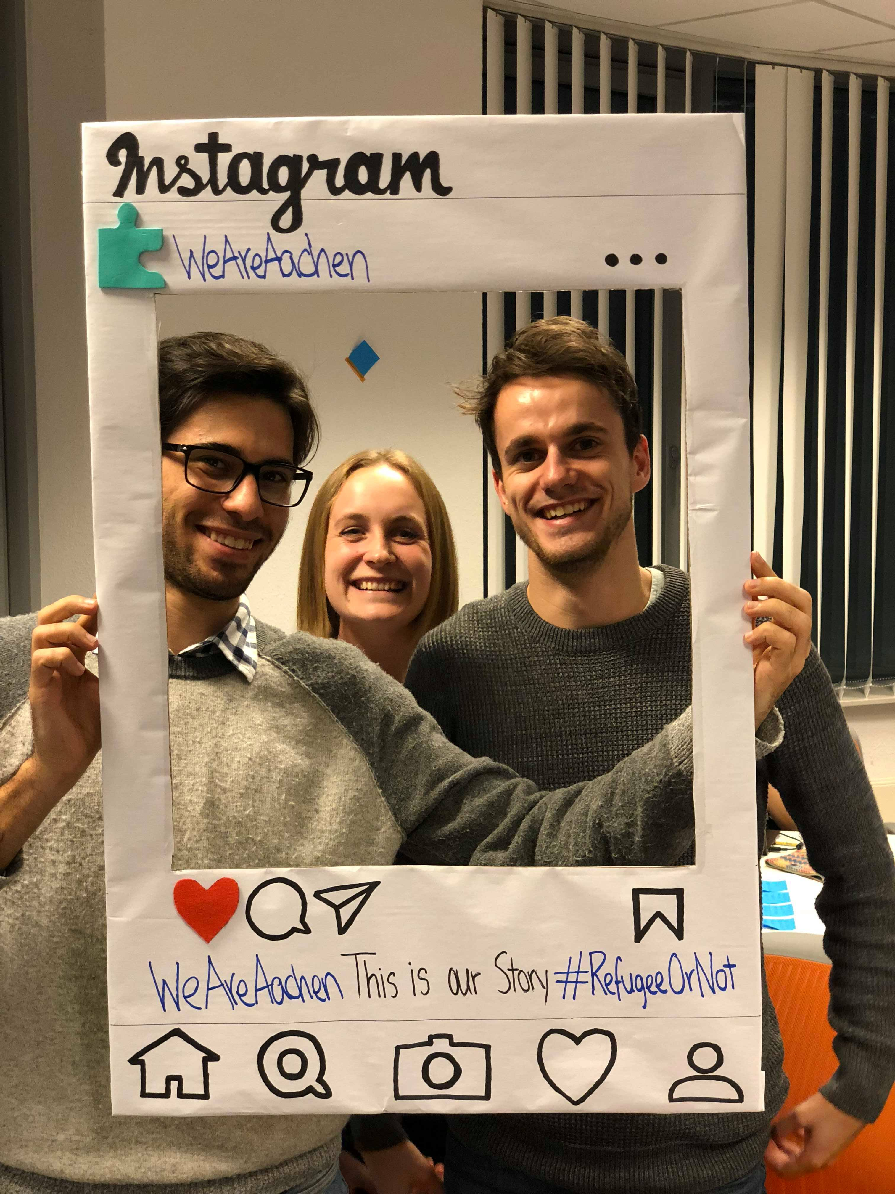
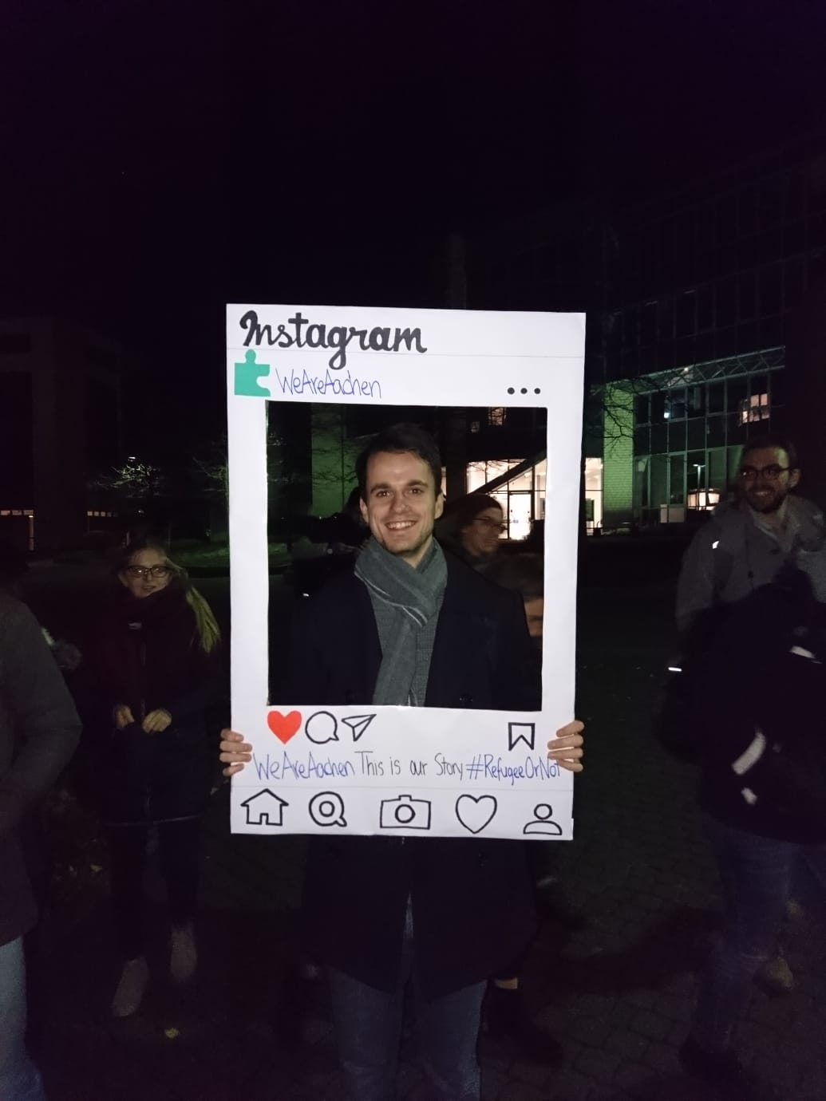
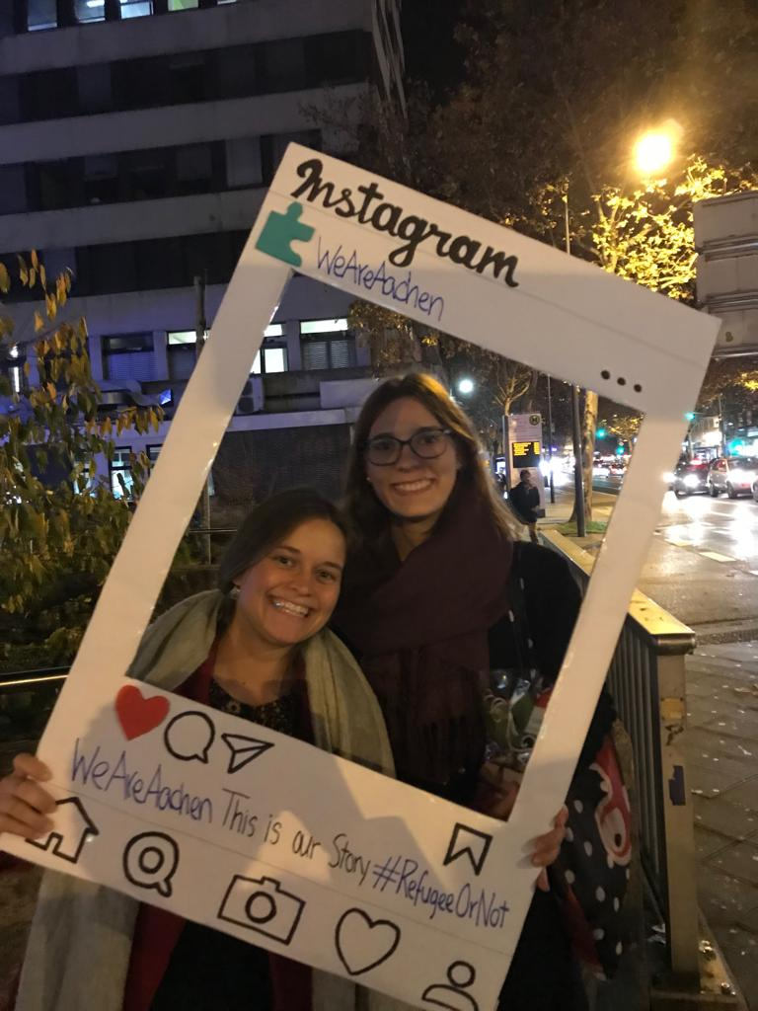
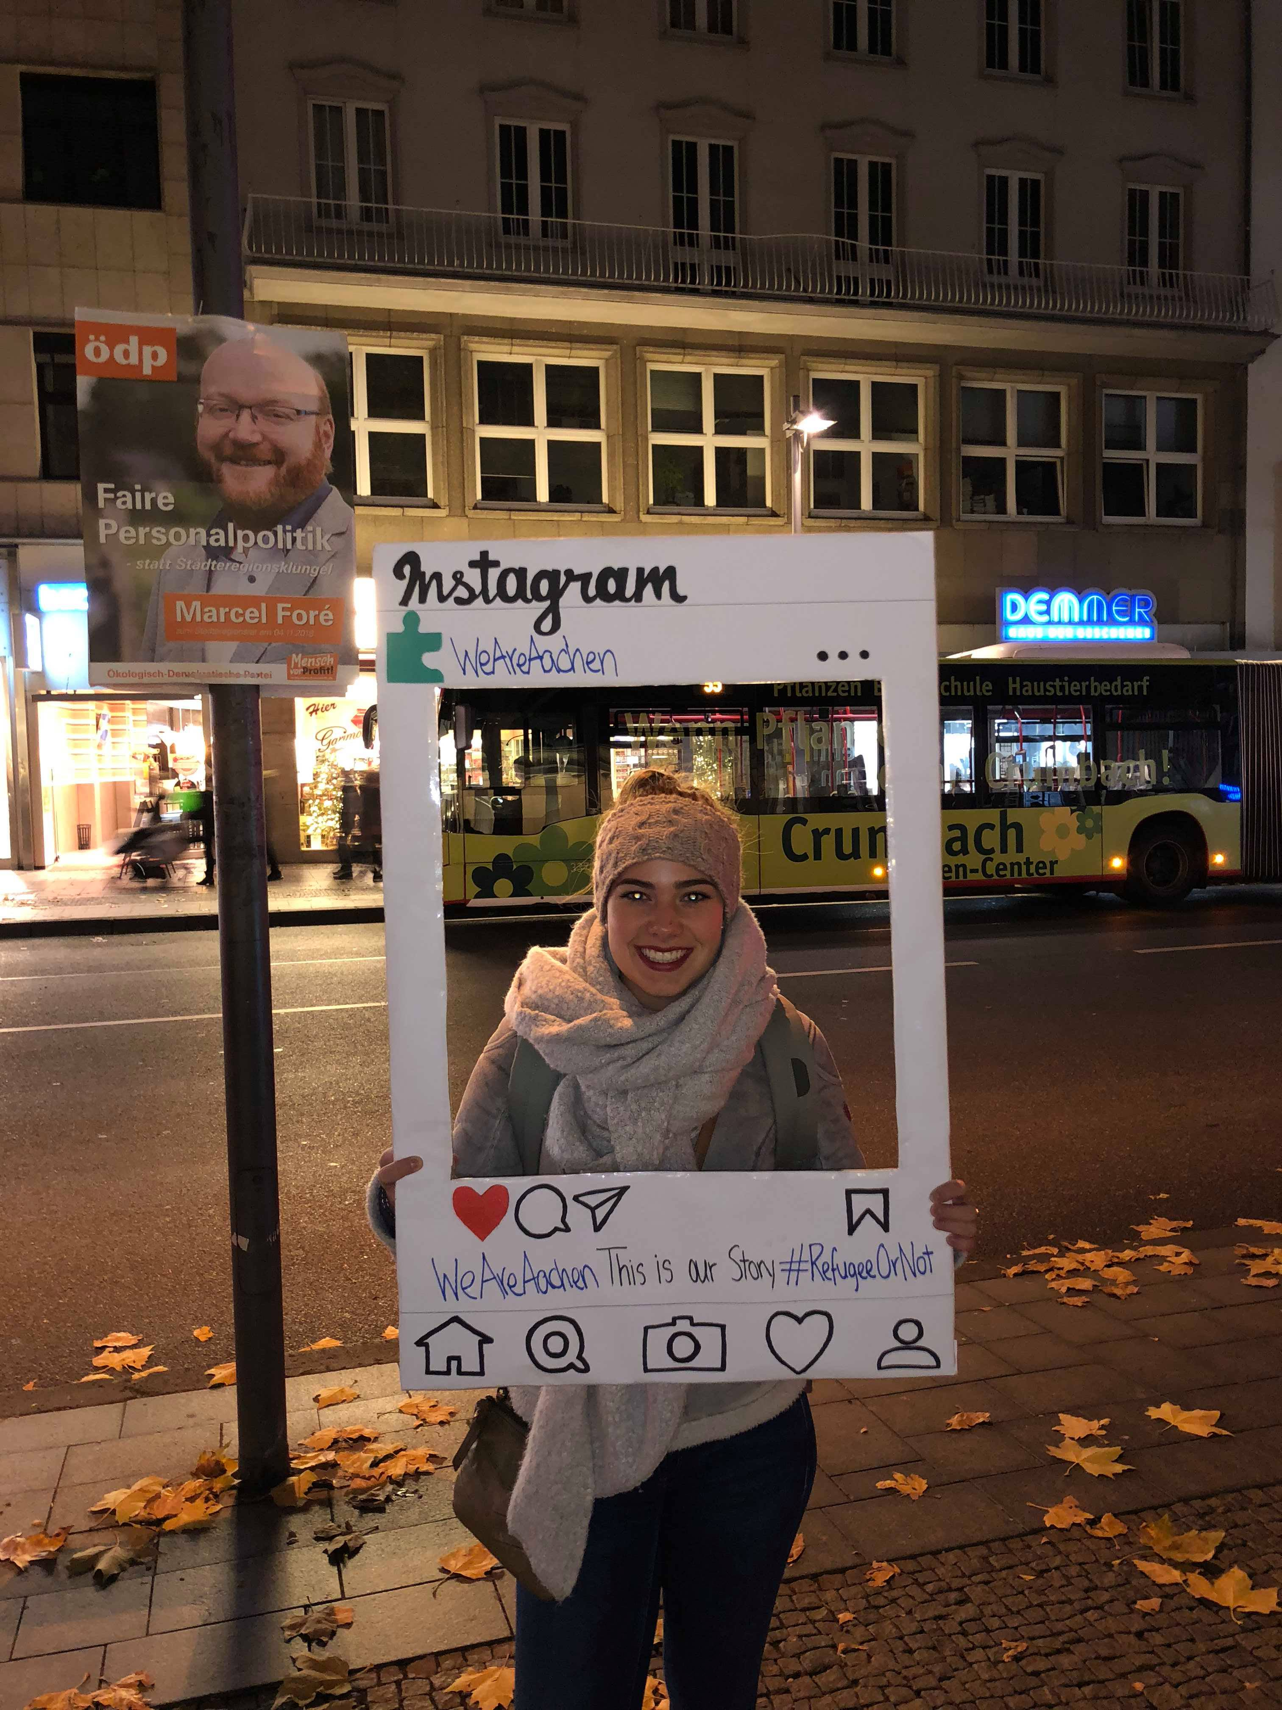
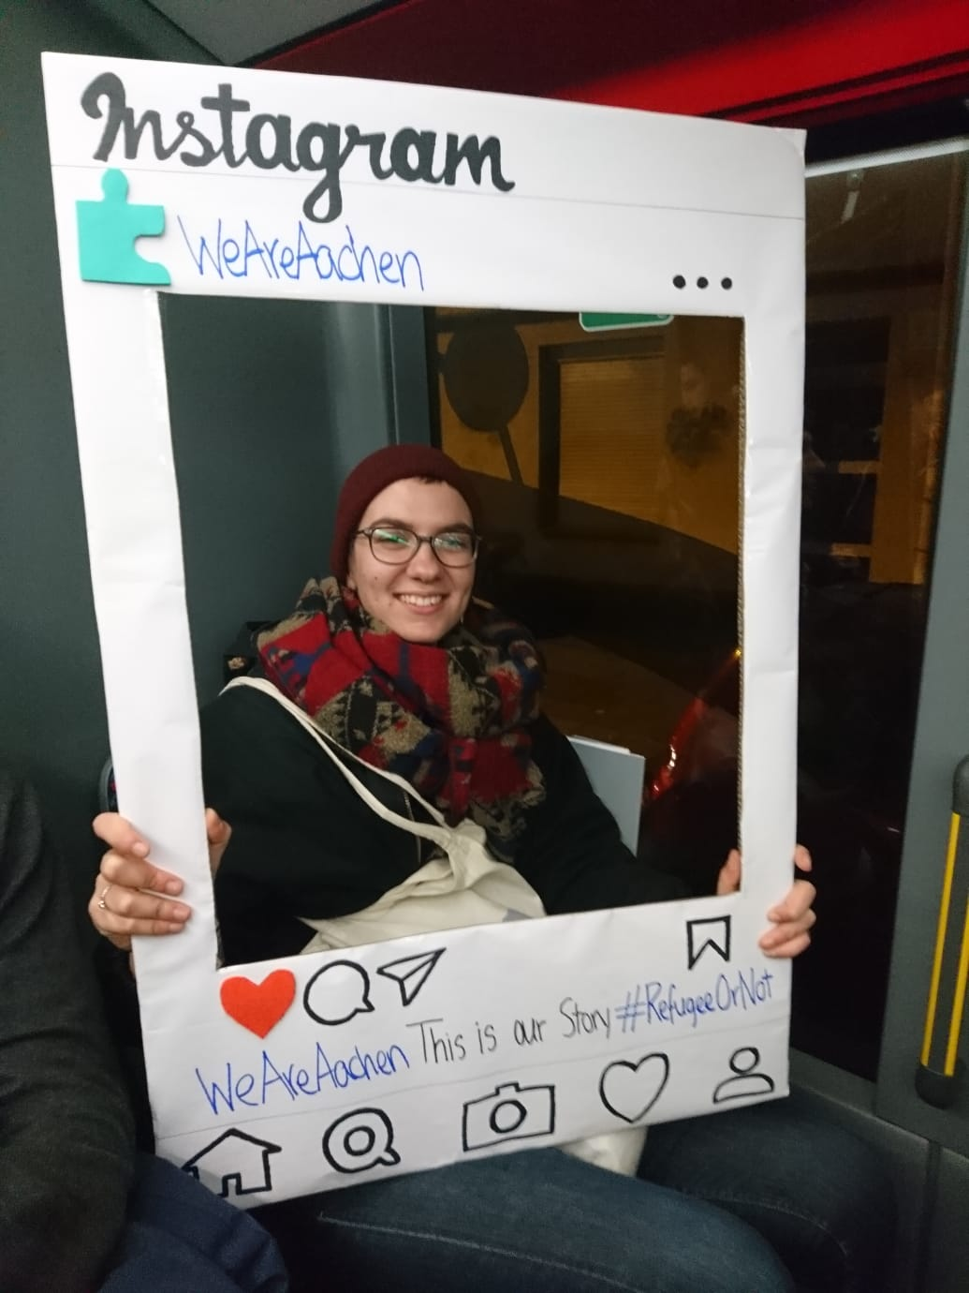
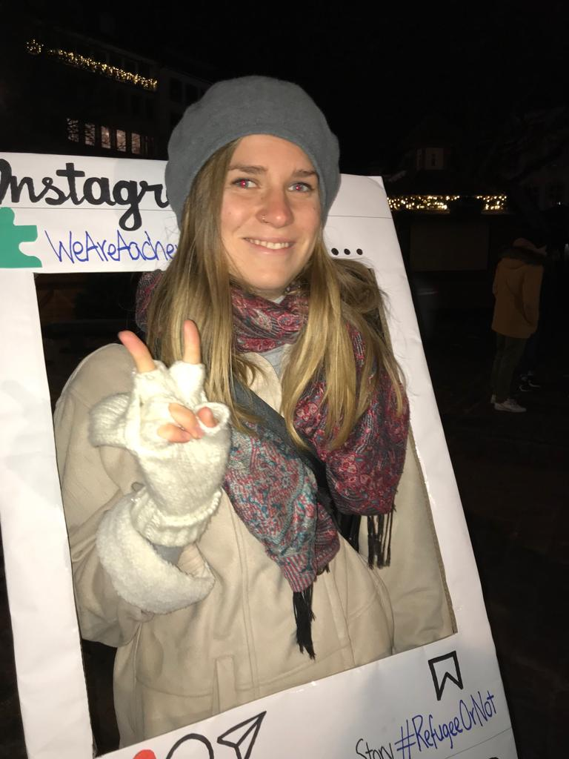
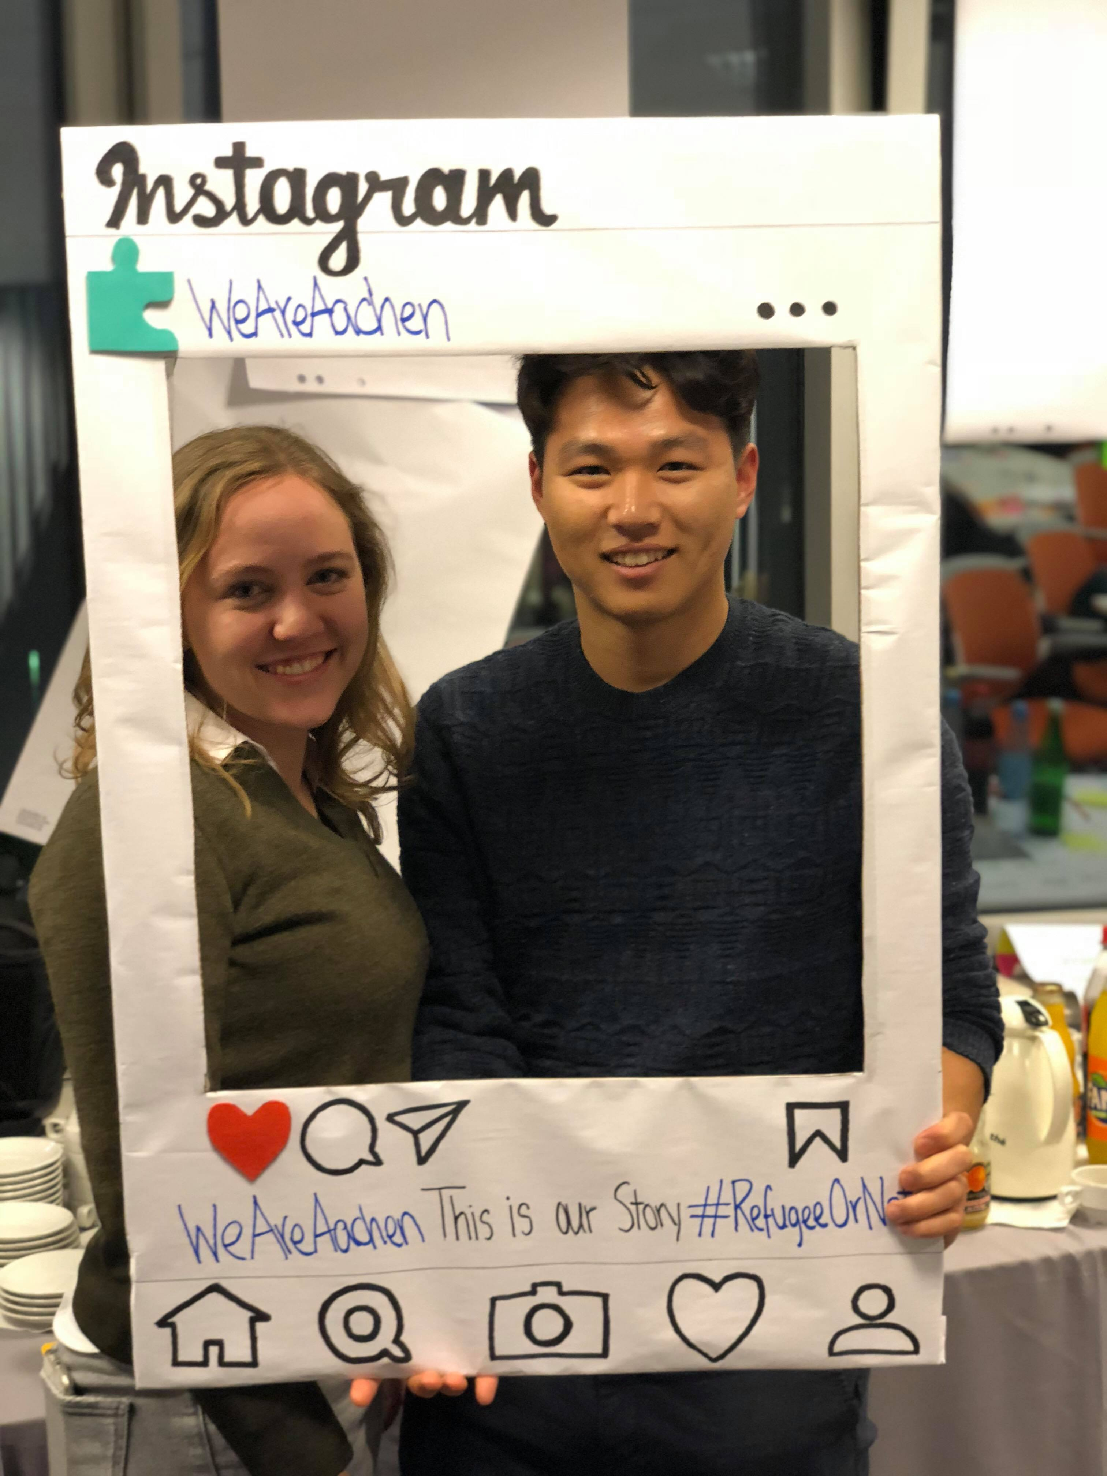
Notes:
Klemens
Explain the Facebook Page
Story 1

Slide 8


Notes:
Jacopo
How did you leverage design thinking in your solution?
Empathising process- painpoints of user, trying to understand
Interviewing refugees and other stakeholders
Got new insights that we were not aware of beforehand
New assumptions that took us further in the process towards designing the concept

Slide 9
We want you to stay
Notes:
Johanna
Fancy ending

Slide 10
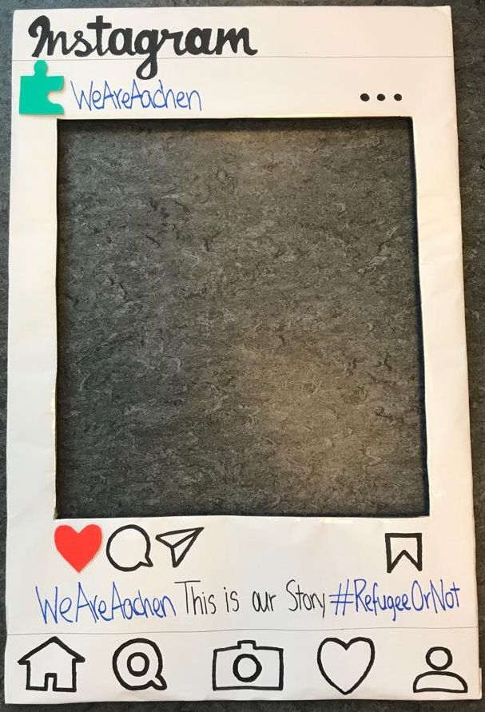
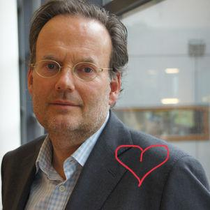
We want you to stay
Notes:
Fancy ending

